Slide 1
Mountain grassland dynamics: integrating phenotypic plasticity in a new agent-based model
Ph.D. defence of
Clément Viguier
realised under the supervision of
Björn Reineking
at IRSTEA Grenoble – LESSEM
Uta Berger
Technische Universitat Dresden
Rapporteur
Marie-Laure Navas
Montpellier SUPAGRO
Rapporteur
Annabel Porte
INRA – Université de Bordeaux
Examinatrice
François Munoz
LECA – Université Grenoble Alpes
Examinateur

Slide 2
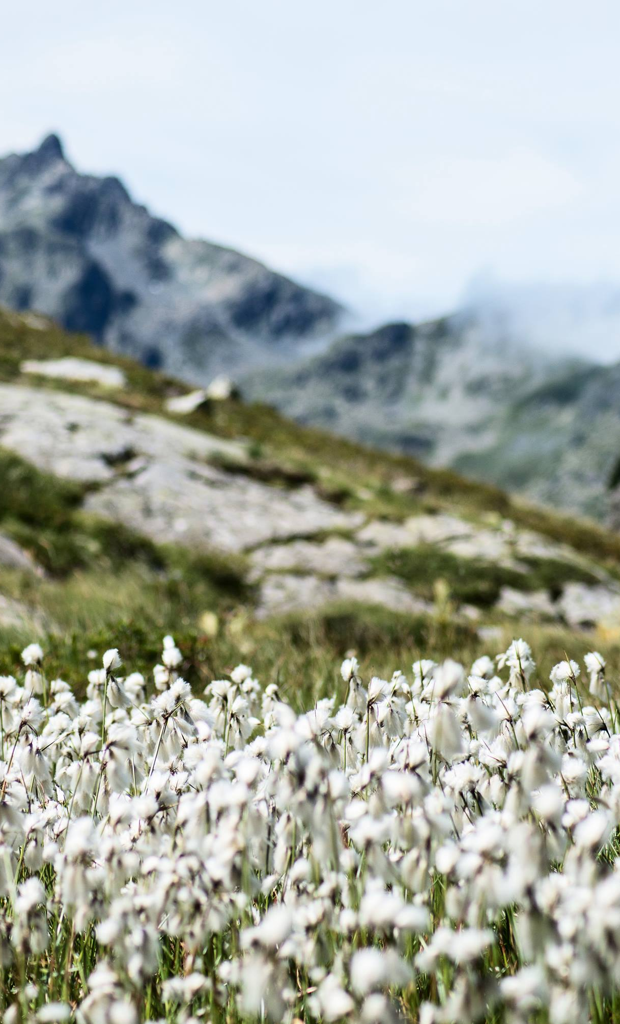
Introduction
1
From context to questions

Slide 3
Mountain grasslands provide services
Flower
production
Various and depends on the properties of the community
Carbon
sequestration
Fodder
productivity

Slide 4
Assessing grassland ecosystem services
Drivers
Community
structure
Summary statistics
Services

Slide 5
Intra-specific variability matters and impacts the community responses
Species
turn-over
Should be considered in:
- ES assessments
Dynamic models
ISV
Jung 2014
Up to 40% of the total variability of some traits.
Strong impact on community response

Slide 6
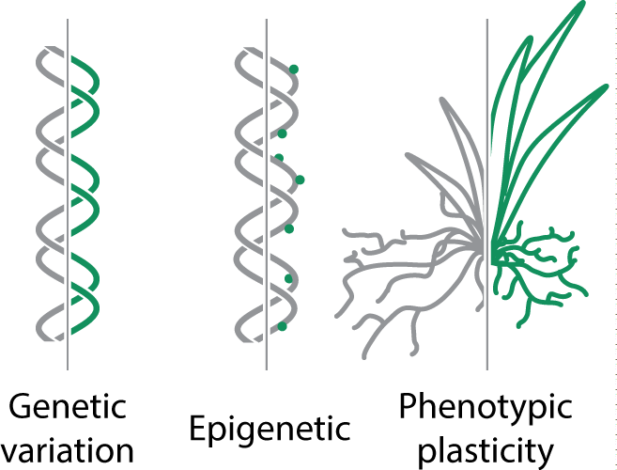
The phenotypic plasticity: one source of variation

Slide 7
The phenotypic plasticity: one source of variation
Rapid response to driver variations
Often overlooked because hard to study in empirical experiments

Slide 8
Mechanistic models to understand
Explicit link with drivers
Understanding by explaining
Emerging behaviour
Experiment at low cost

Slide 9
How does phenotypic plasticity impact grassland community structure?
Species diversity and dominant strategies

Slide 10
How does phenotypic plasticity impact grassland community structure?
How model diverse plant communities integrating phenotypic plasticity?

Slide 11
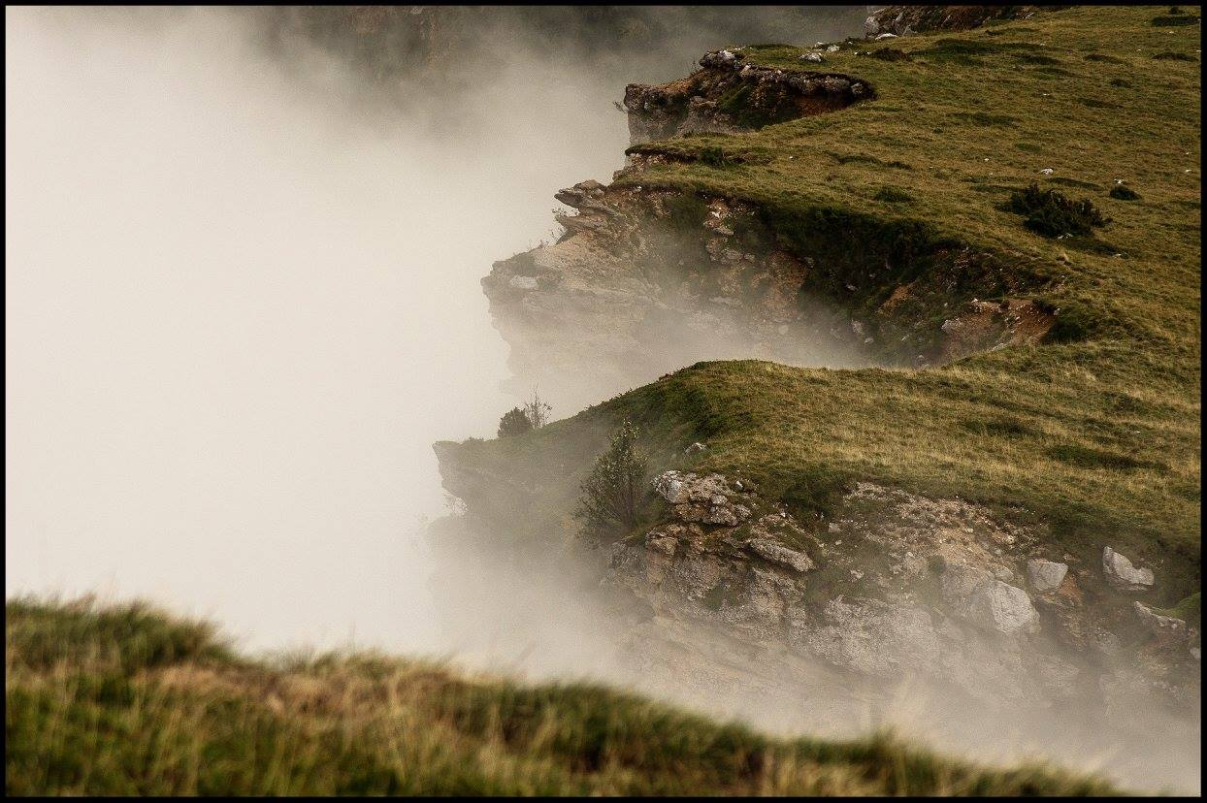
Concepts
2
From ecological concepts to the model MountGrass

Slide 12

Keys concepts

Slide 13
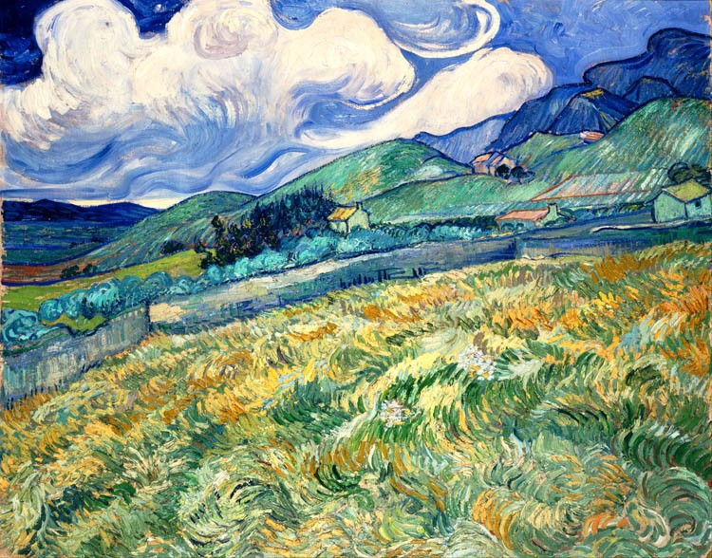
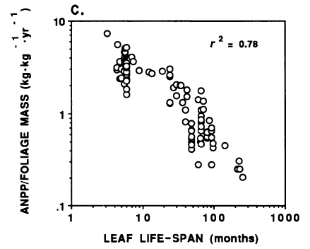
Niche and variability
Competition for resources
Strategy trade-ffs
P. Reich (1992)

Slide 14
Niche & variability
Site env. variability
Fitness
Fit of a species under specific environmental conditions
Variability promotes coexistence
True for spatial and temporal variability
Env. gradient
Community
P. Reich (1992)

Slide 15
Competition for resources
Is the main plant interaction mechanism
Shapes communities by affecting the realised niches
Depends on plant strategies
P. Reich (1992)

Slide 16
Strategy trade-offs
Plant strategies are constrained
→ Dimension reduction
Continuum of plant strategies
Build a strategy space
P. Reich (1992)

Slide 17
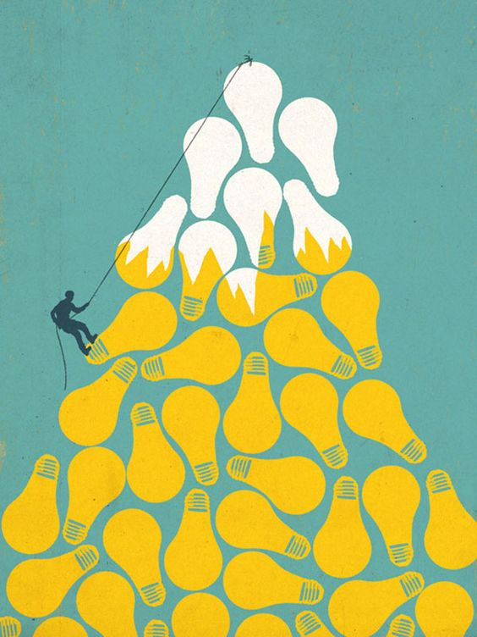
The model MountGrass

Slide 18
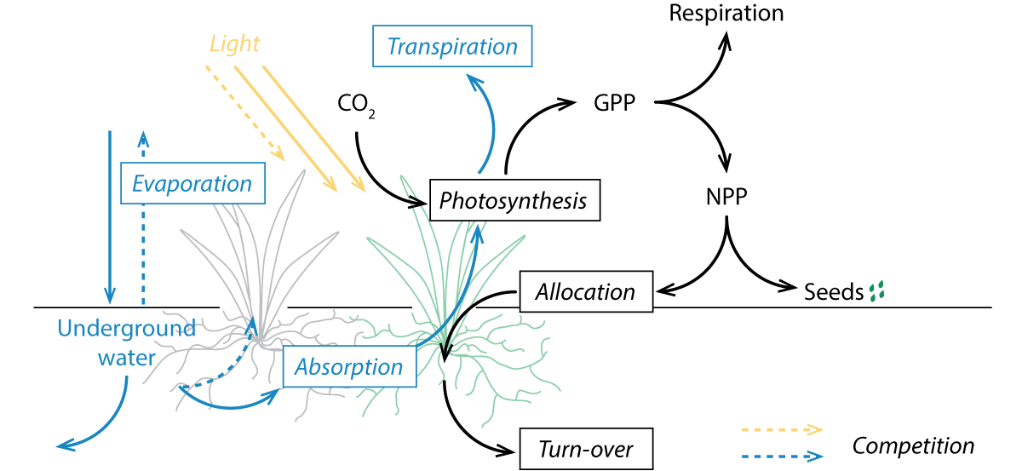
MountGrass’ processes
Response to drivers: physiological processes.
Above and belowground competition: light and water cycles.
Strategies: carbon allocation trade-offs.

Slide 19
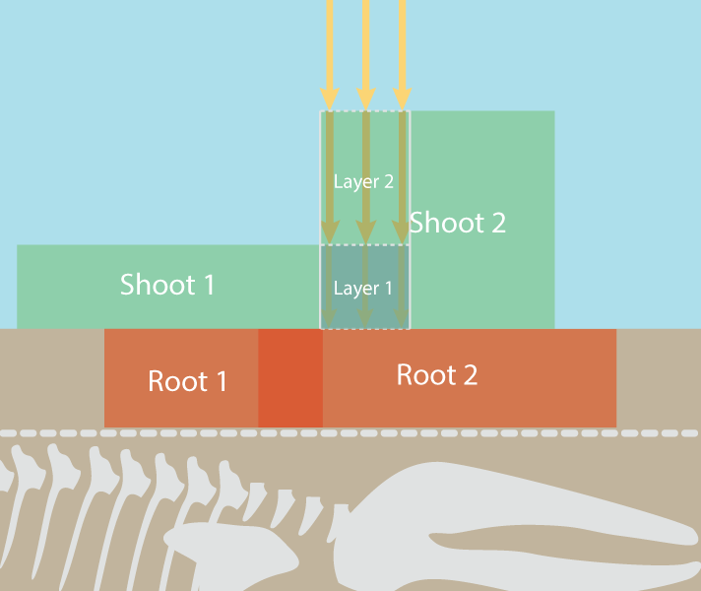
Space & time: the individual plant scale
Individual-based model
spatialy explicit: explicit competittion
1 cm resolution
daily time-step

Slide 20
Plant carbon pools and allocation trade-offs
6 vegetative pools
3 dimensions:
Root:shoot ratio
Prop. active in shoot
Prop. active in root
Allocation trade-offs
→ strategic trade-offs

Slide 21
Allocation trade-off into strategic trade-off
Exploitative
Tissue density
Tissue lifespan
Proportion of active tissues
in shoot (PAS)
Conservatives
Area/biomass

Slide 22
Phenotypes and strategies
PAS
PAR
Root:Shoot

Slide 23
Phenotypes and strategies
Each point is a valid strategy
PAS
PAR
Root:Shoot

Slide 24
Phenotypes and strategies
Each point is a valid strategy
PAS
PAR
Root:Shoot
→ sample diverse strategies in a continuous space

Slide 25
Phenotypes and strategies
Each point is a valid strategy
PAS
Plasticity allows plant to move within this closed space.
But it needs rules.
PAR
Root:Shoot

Slide 26
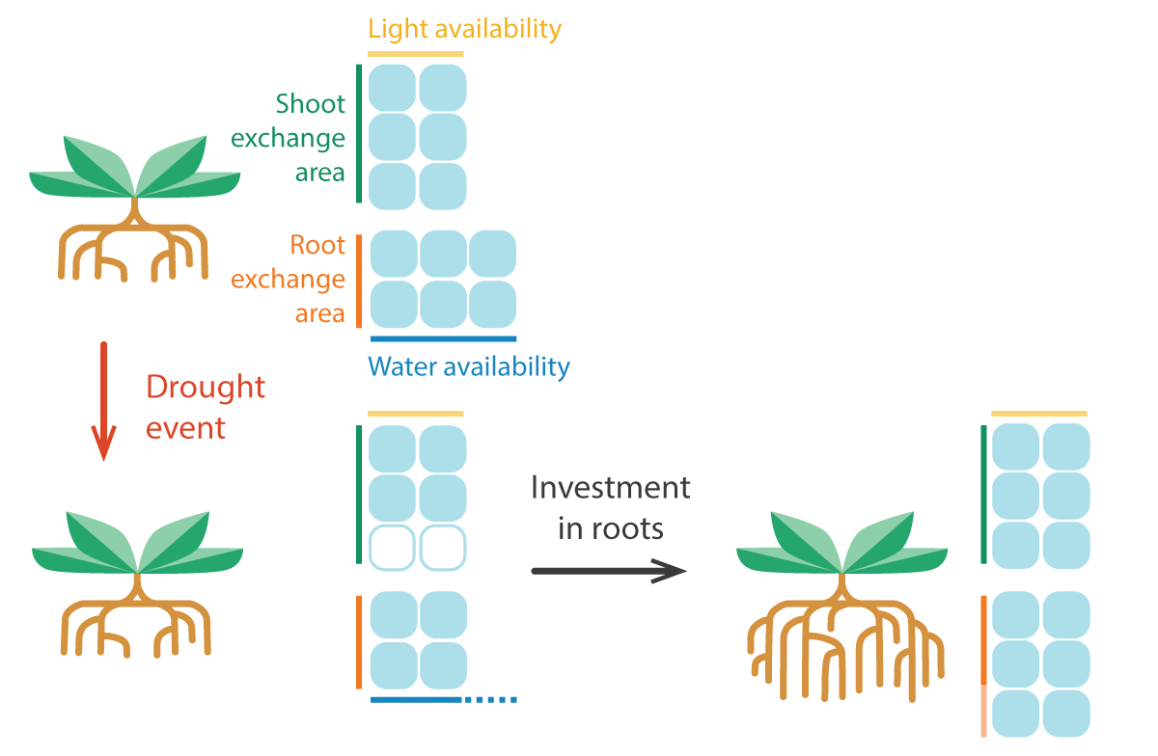
Plasticity: the functional equilibrium
Objective function: root activity = shoot activity
Plastic dimension: Root:Shoot ratio
Assumption: tomorrow same as today
Potential
evapotranspiration
Potential root
absorption
« fixed-equilibrium »
= changes in Root:Shoot only
PAS
Root:Shoot
PAR

Slide 27
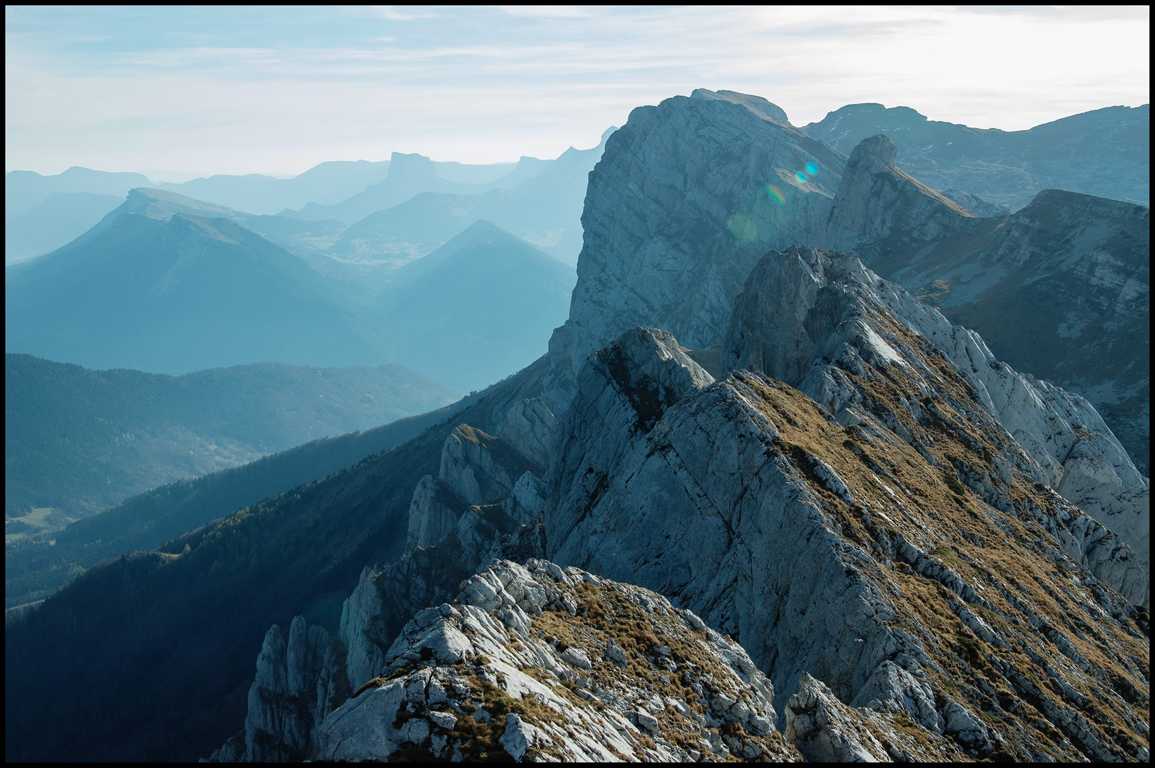
Results
3
Individual- and community-level effects of plasticity

Slide 28
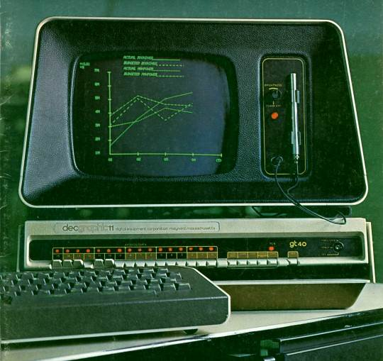
Parameter
filtering
1 parameter set
= 31 values
31 parameters
Pot growth patterns in 2 treatments of precipitation
→ Selection of a subset of parameter sets for simulations
Accepted sets
Simulation sets
Trend from multiple simulations
111 days
fixed T° & irradiance
12*12*90 cm pots

Slide 29
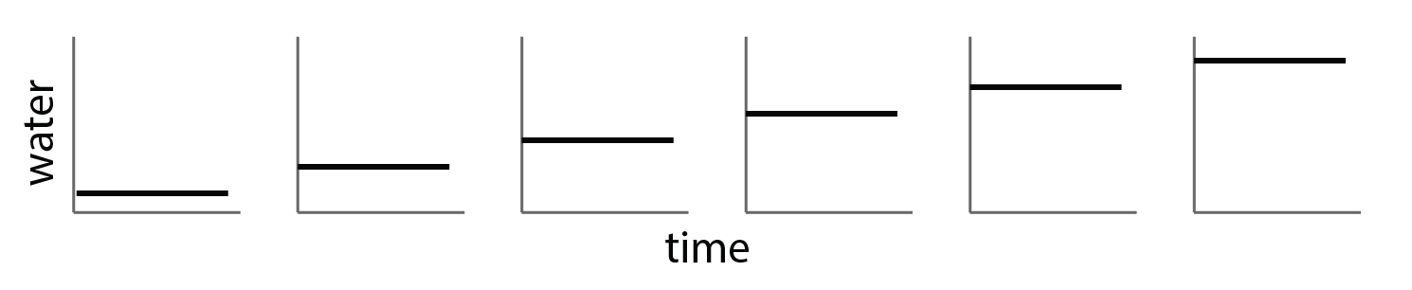
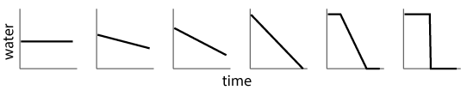
Individual-level simulations
fixed T° & irradiance
12*12*90 cm pots
100 days
How does plasticity affect community response to spatial and temporal variability?
Individual growth along an availability gradient (spatial)
Individual growth along an variability gradient (temporal)
1 dimension: water → observe the effect of plasticity on biomass and optimum root strategy (PAR)

Slide 30
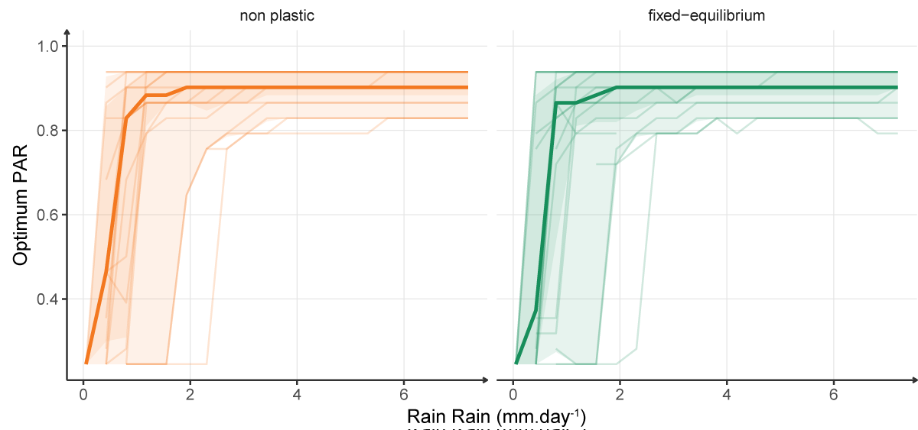
Plasticity effect in homogeneous conditions
Optimum strategy along a water availability gradient
No shift in best strategy
No change in maximum biomass

Slide 31
Plasticity effect in homogeneous conditions
Optimum strategy along a water availability gradient
No shift in best strategy
No change in maximum biomass
No shift in the dominant species

Slide 32
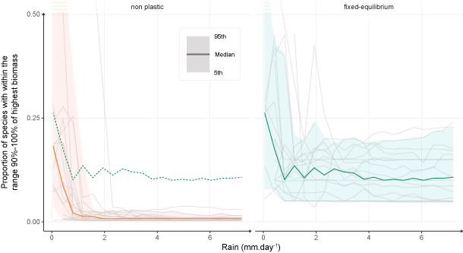
Plasticity effect in homogeneous conditions
Proportion of species with high performances along a water availability gradient
Reduction of growth differences
Niche widening

Slide 33
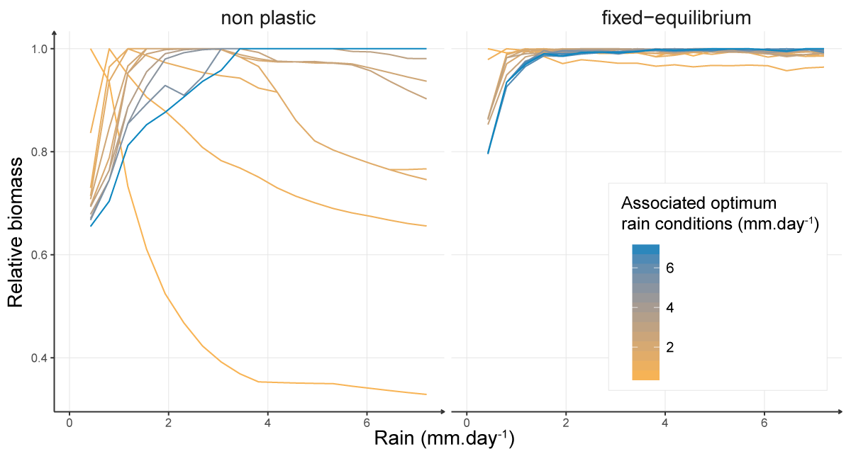
Niche widening in homogeneous conditions
Potential niche of best species
Plasticity
→ increases relative biomass in non optimum conditions
for 1 parameter set

Slide 34
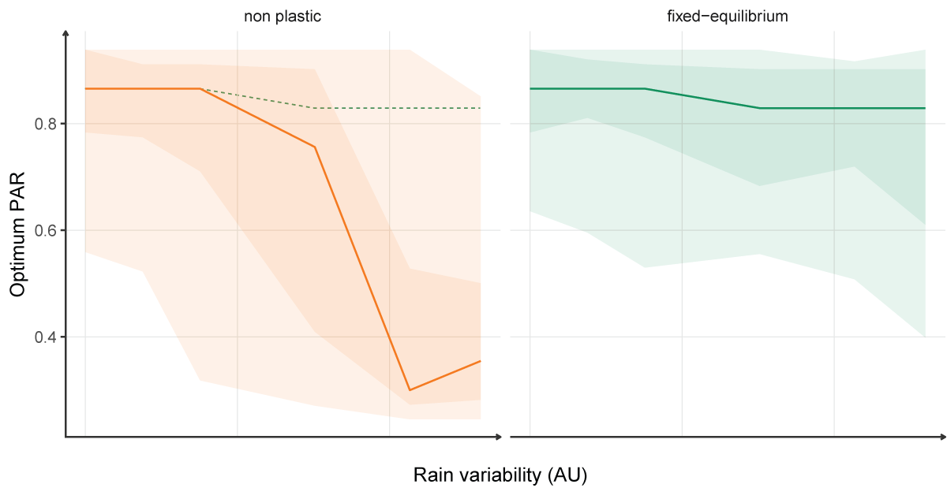
Plasticity effect in heterogeneous conditions
Optimum strategy along a water variability gradient
Changes in dominant strategy in favour of exploitative species
Reduction of growth differences
Increase of relative BM

Slide 35
Plasticity effect in heterogeneous conditions
Optimum strategy along a water variability gradient
Changes in dominant strategy in favour of exploitative species
Reduction of growth differences
Increase of relative BM
Asymmetric gain (+exploitative strategies)
Niche widening

Slide 36
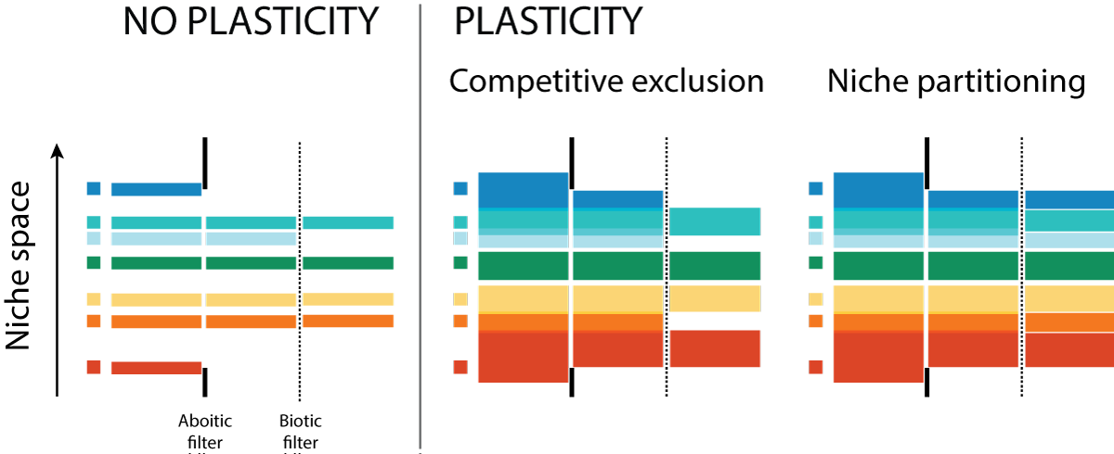
Consequences at the community level ?
Niche widening = reduction of abiotic filtering + reduction of fitness differences

Slide 37
Consequences at the community level ?
Niche widening = reduction of abiotic filtering
higher potential species diversity
Asymmetric gain
Competitive exclusion by exploitative species?

Slide 38
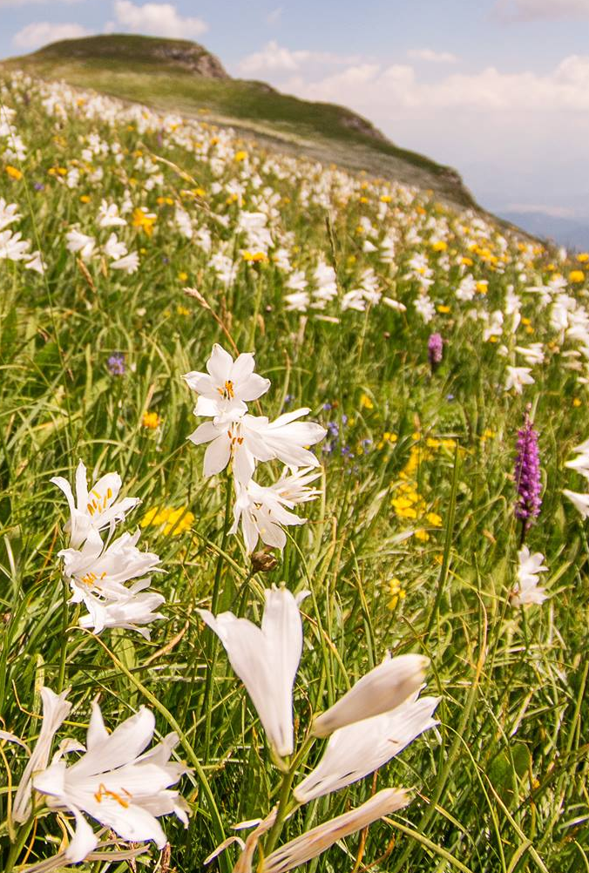
Community-level simulations
Real conditions of variability (weather data for 6 sites) + explicit competitive interactions
Long term simulations (300 years)
12 stable parameter sets (reproducing individual after 50 years in non plastic conditions)
400 different phenotypes
6 sites: meta-community
100*100cm plots
6 sites:
variable T°, prec. & irradiance

Slide 39
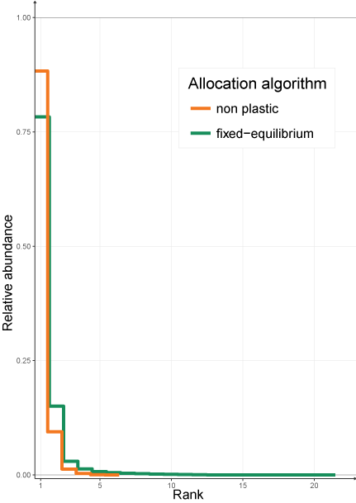
Effects of plasticity on species diversity
Median species abundance per rank
Lower abundance of the dominant species
Higher species diversity

Slide 40
Effects of plasticity on species diversity
Median species abundance per rank
Lower abundance of the dominant species
Higher species diversity
Niche widening > asymmetric gain

Slide 41
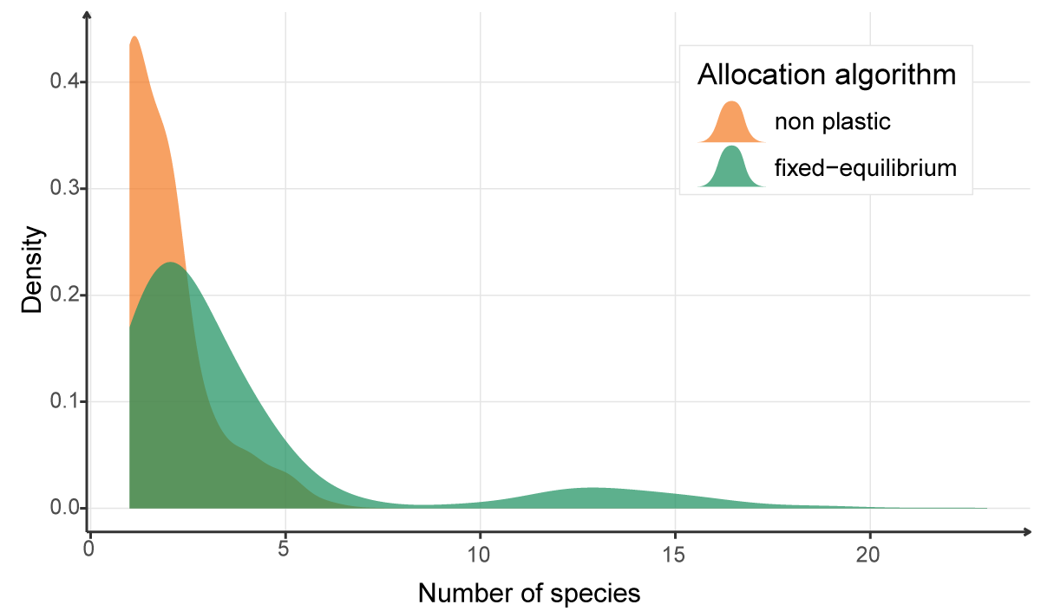
Effects of plasticity on species diversity
Median species abundance per rank
Distribution density of species diversity in simulated communities
Niche widening > competitive exclusion

Slide 42
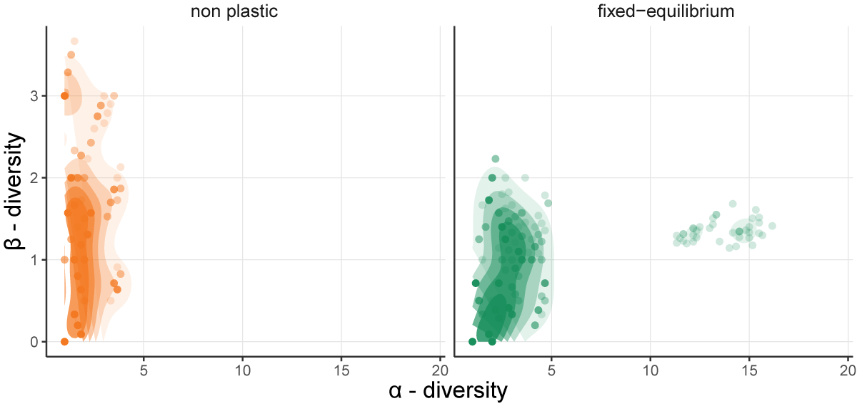
A shift in community structure?
Species diversity structure
Shift in diversity structure:
Less distinct site communities
Richer site communities
Between sites
Within sites

Slide 43
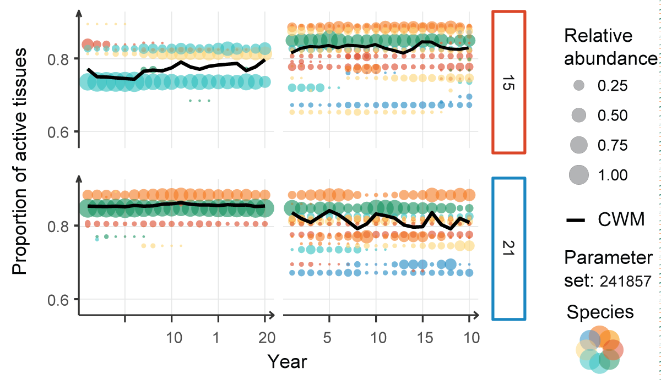
A shift in community structure
More species → abundance variations but no composition shifts
Species diversity structure
Community composition for 2 sites
Between sites
Within sites

Slide 44
Results summary
Niche widening
Assymetric gain in favour of exploitative species = loose of sensitivity to resource variability
Niche widening > asymmetric gain
Plasticity alters meta-community structure

Slide 45
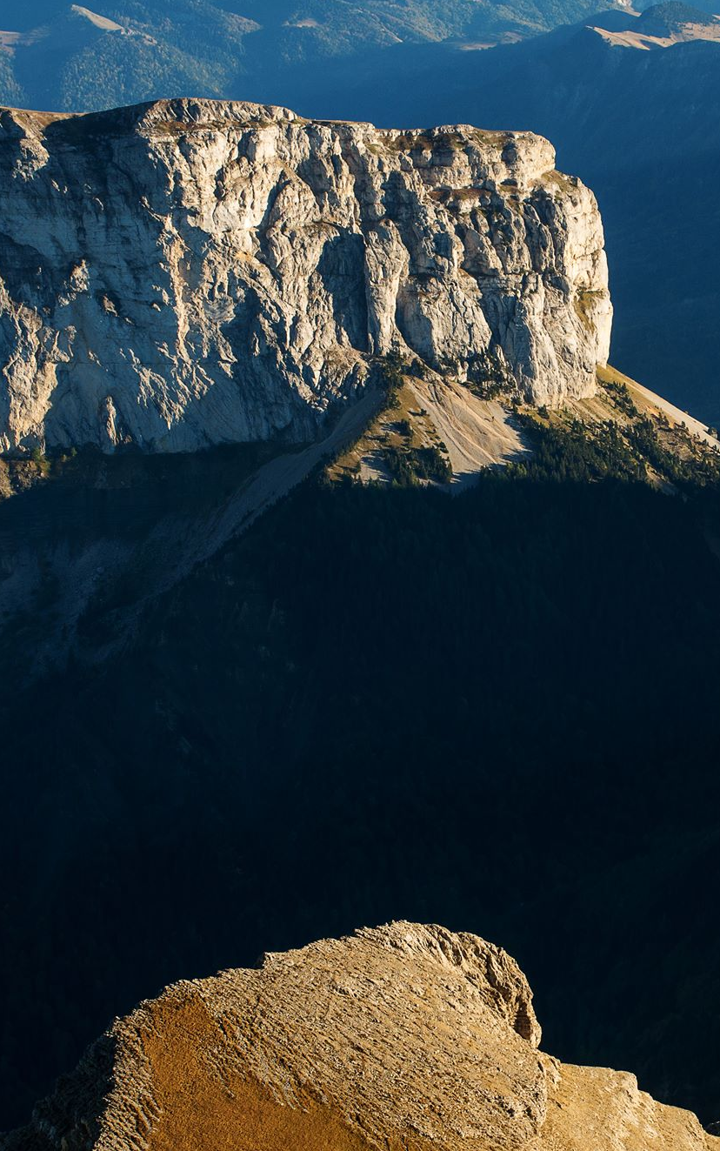
Discussion
4
Impact on community dynamics and community modelling

Slide 46
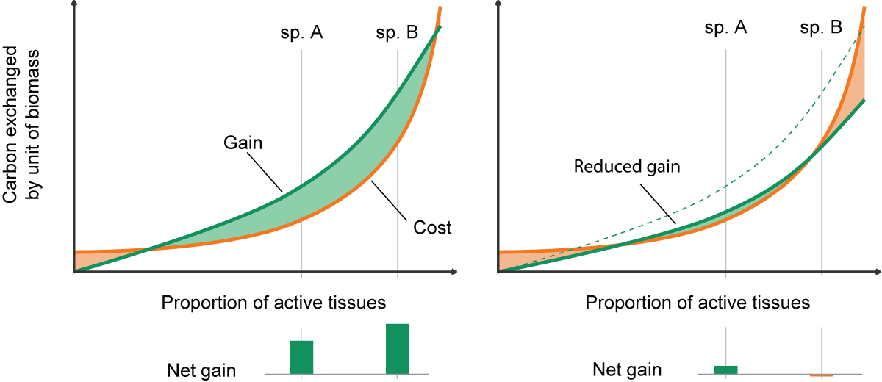
How plasticity favours exploitative species?
Conservative species have a greater efficiency but lower exchange rate
Exploitative species are sensitive to unbalanced organ activities
Plasticity ensures this balance and negates the sensitivity of exploitative species

Slide 47
Transfer to real systems?
There is not switch in reality
Is plasticity that important
Theoretical model
Plasticity as a trait
How deep should we go in the rabbit hole? To more and more complex traits?

Slide 48
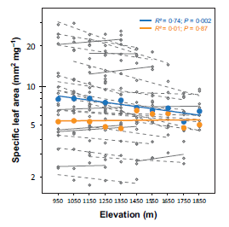
Risk of functional convergence?
Due to the reduction of niche differences?
Supported by other processes than the variability in resources
Of plastic traits ?
Plasticity cost
New forms of plasticity

Slide 49
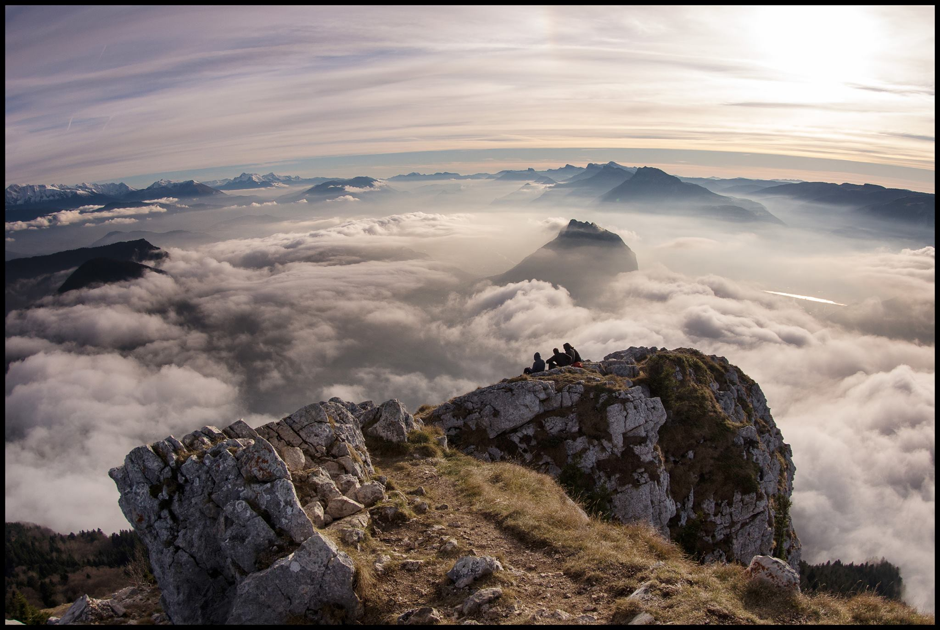
Conclusions & Outlook
5
New hypothesis and simulations
Model developments

Slide 50
Ecological conclusions:
A better undertanding of plasticity
Better understanding as an integrated growth process not just a response function
Plasticity impacts diversity via multiple mechanism at multiple scales
Plasticity is rarely symmetric (niche widening promotes subordinates species, assymetric gain favours certain strategies)

Slide 51
Ecological conclusions:
A diverse community framework
Diversity in strategies and species
Plasticity in coherent framework
Plasticity as a strategy (not explored)
but…
A lot of parameters: needs better calibration and sampling
High functional convergence

Slide 52
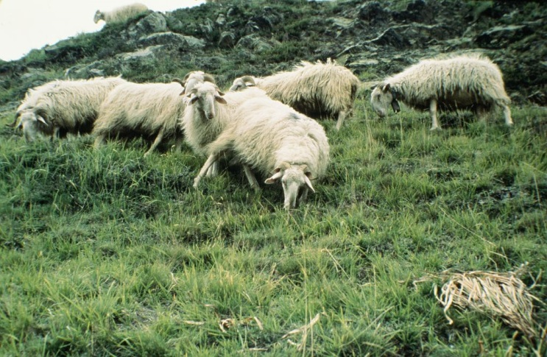
To go beyond
Better calibration and strategy sampling to confirm results
Explore the plasticity as a strategy
Climat, management and perturbation scenarios

Slide 53
Thank you!

Slide 54
Bonus!

